Slide 1
Action Recognition in Video
Pascal Mettes – University of Amsterdam
VISUM summer school

Slide 2
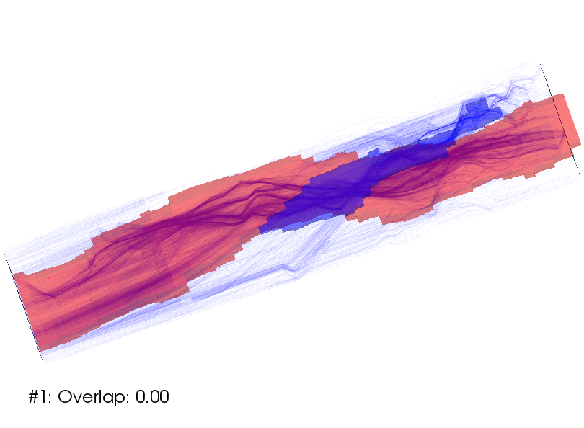
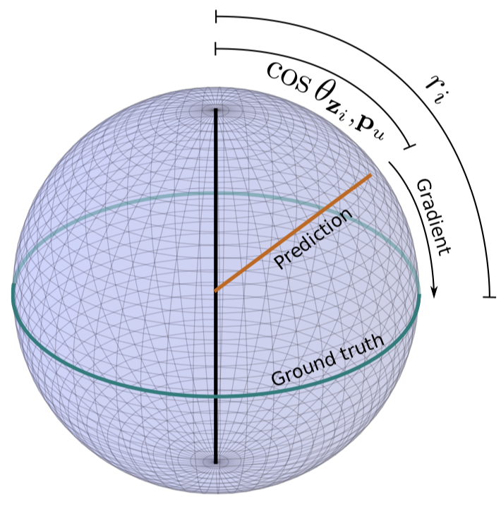
A short introduction
Assistant Professor at University of Amsterdam
Formerly at UvA (PhD, postdoc) and Columbia University (visiting).
Research interests in action understanding and deep learning for vision.

Slide 3
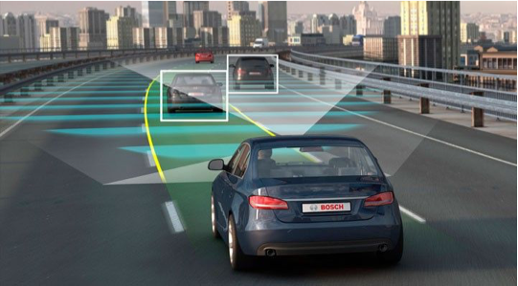
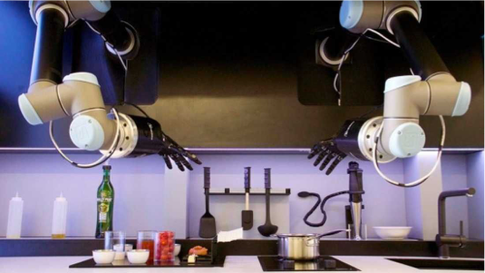
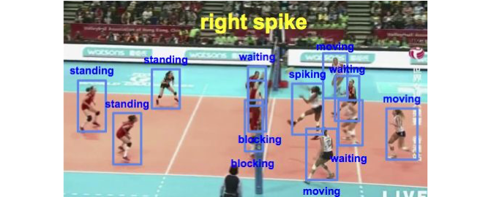
The core topic of this session

Slide 4
Session outline
Session I 14:00-14:45
Representing videos for action recognition
Session II 15:00-15:45
Action and video understanding without labels
Session III 16:00-16:30
Recent advances in action understanding

Slide 5
Session I
Representing videos for action recognition

Slide 6
Challenges in video understanding
Intra-class variations.
Non-rigid motions.
Human appearance/pose variations.
Unclear definition of actions.
Occlusion, lighting, viewpoints etc.

Slide 7
Video recognition pre deep learning
Initial work centered around 3D feature generation, akin to SIFT.

Slide 8
Video recognition pre deep learning
[Wang et al. IJCV 2013]
Dense trajectories were the king of the jungle for a long time.
Deep learning only started beating this by end of 2016.
Main idea: track short sequences
using optical flow and compute
multiple features along these
sequences.

Slide 9
Recognizing actions with deep learning
Generation 1: Pooling over time.
Generation 2: Time as a channel dimension.
Generation 3: Time as a spatial dimension.
Other approaches

Slide 10
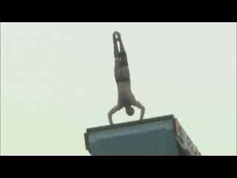
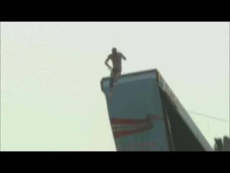
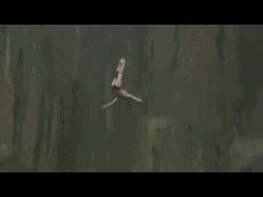
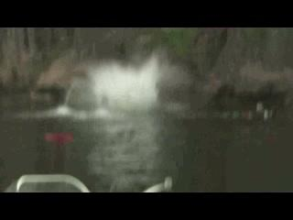
[Gen 1] Pooling
Image courtesy of Amir Ghodrati
CNN
CNN
CNN
CNN
Pooling

Slide 11
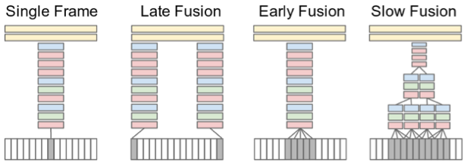
[Gen 1] Different approaches to pooling
[Karpathy et al. CVPR 2014]
Equate a video to a frame, fuse scores, or stack frames.

Slide 12
[Gen 1] Is an order-less encoding bad?
Pros:
Easy to implement, very efficient.
Use pre-trained models from image classification.
Useful for high-level video tasks, such as event recognition.
Cons:
Bad for fine-grained tasks, e.g. throw vs catch.
Motions ignored, true essence of actions is missed.

Slide 13
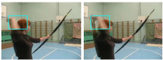
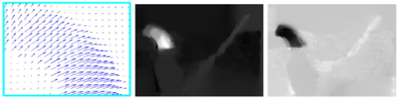
[Gen 2] Two-stream networks
[Simonyan and Zisserman. NeurIPS 2014]
Use optical flow as “frames” and extra input for a deep network.
Compute optical flow for a video,
stack flow frames and apply a
standard 2D convolutional
network.

Slide 14
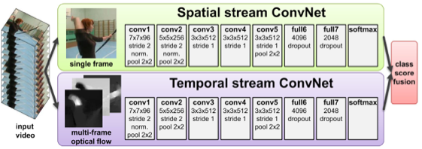
[Gen 2] Two-stream networks
Separate convolutional networks for individual frames and flow frames.
Fuse scores from individual networks for final prediction.

Slide 15
[Gen 2] Two-in-one stream networks
[Zhao and Snoek. CVPR 2019]
Do we need double the parameters when used two streams?

Slide 16
[Gen 2] Modulation visualization
Use flow stream to highlight interesting regions in RGB stream.

Slide 17
[Gen 3] 3D Convolutional networks
Learn filters that move locally in space AND time.
Treat the temporal dimension as another spatial dimension.

Slide 18
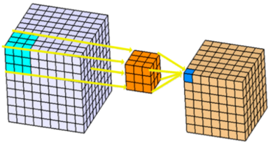
[Gen 3] 3D Convolutional layer
Input: W x H x T x C₁
Kernel size: K x K x K
Output for C₂ kernels?
W x H x T x C₂

Slide 19
[Gen 3] Channel and time dimension
2D convolution: locally in width and height, along all channels.
3D convolution: locally in width, height, and time, along all channels
channel
Time

Slide 20
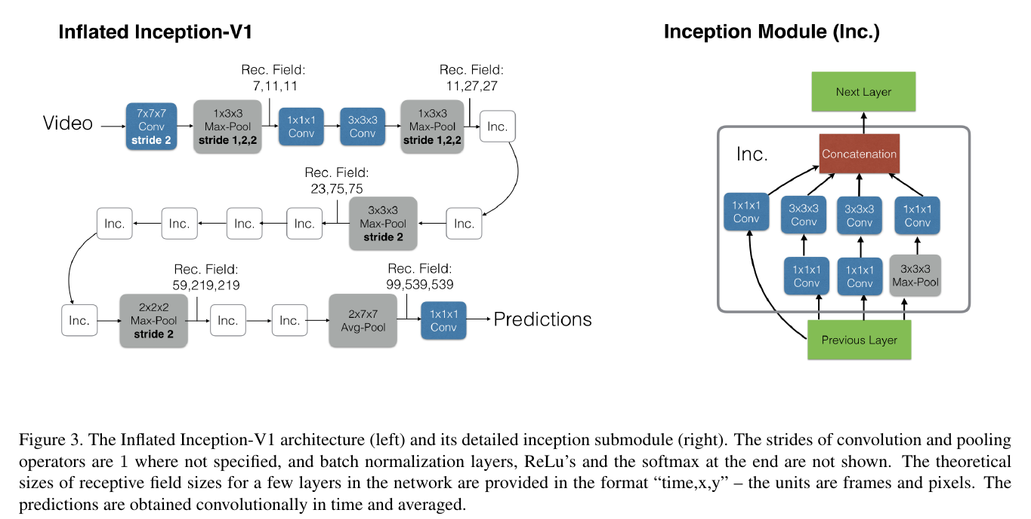
[Gen 3] Inflated 3D (I3D) network
[Carreira and Zisserman. CVPR 2017]
State-of-the-art network for action recognition.
Two-stream 3D ConvNet.
Inflate network architecture
and weights from images.
Pre-training on ImageNet.
Pre-training on Kinetics.

Slide 21
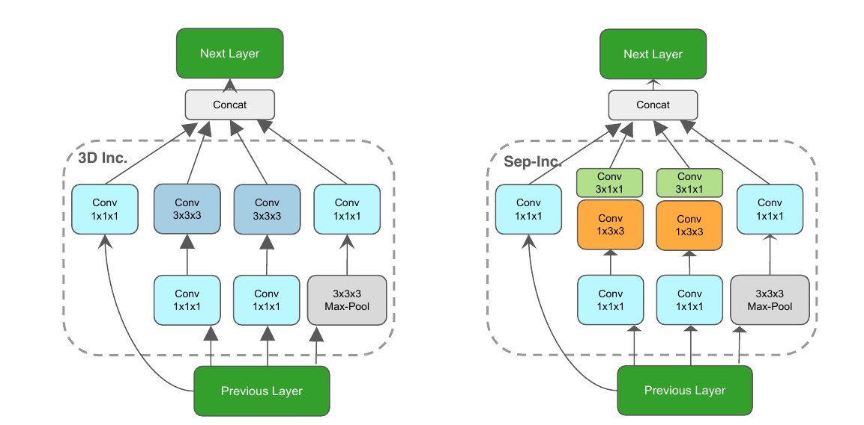
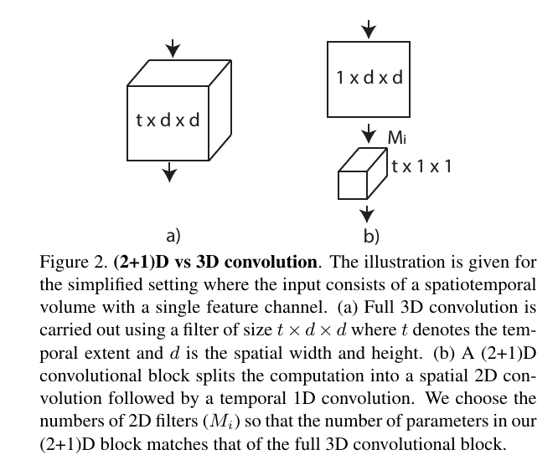
[Gen 3] (2+1D) networks
[Tran et al. CVPR 2018]
Split into space-then-time for fewer parameters and computation.

Slide 22
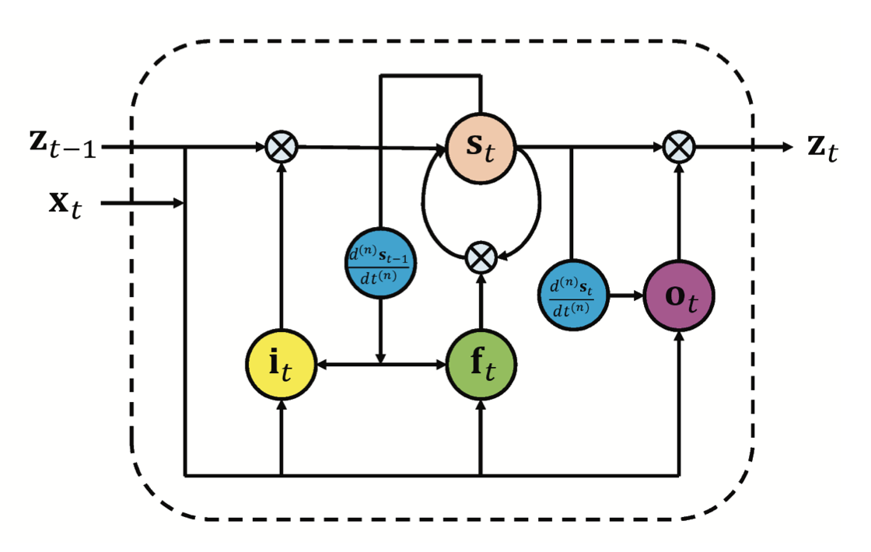
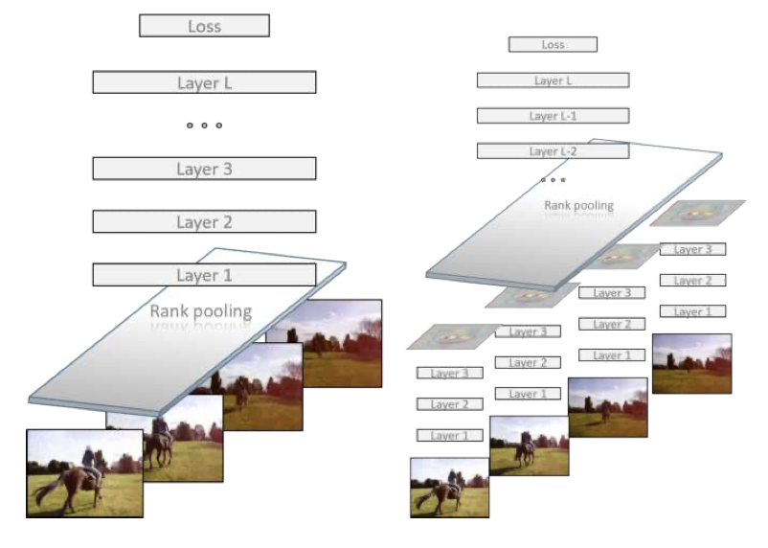
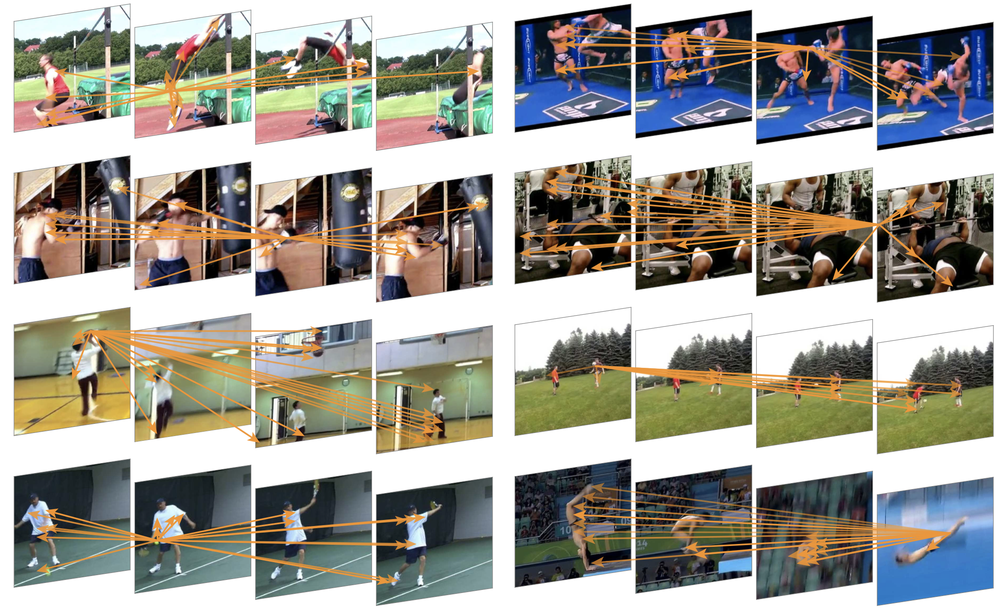
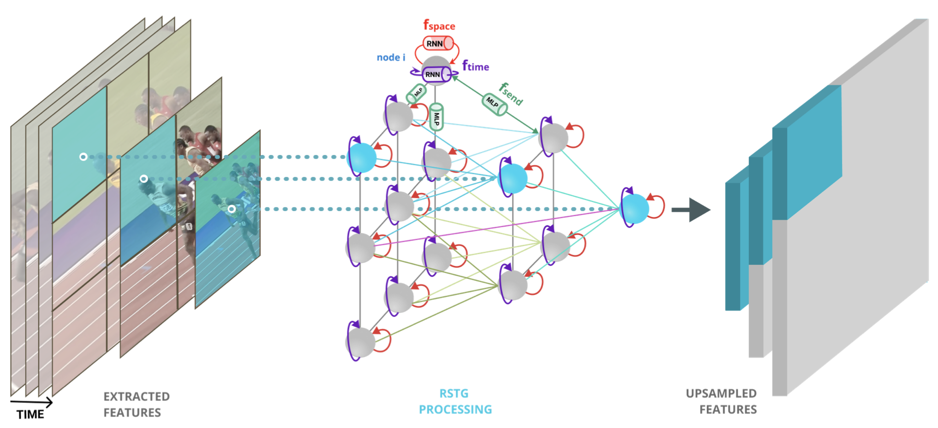
Other approaches
Recurrent video recognition
RankPooling / dynamic images
[Veeriak et al. ICCV 2015]
[Bilen et al. CVPR 2016]
Non-local approaches
Hybrid approaches
[Wang et al. CVPR 2018]
[Nicolicioiu and Duta. NeurIPS 2019]

Slide 23
On representing videos
Time as a separate dimension.
Recognizing actions versus context.
Videos as graphs.
Normal videos
No background
No actor
Other actor
When trained on videos, which setting works best?
And which one worst?

Slide 24
Session II
Action and video understanding without labels

Slide 25
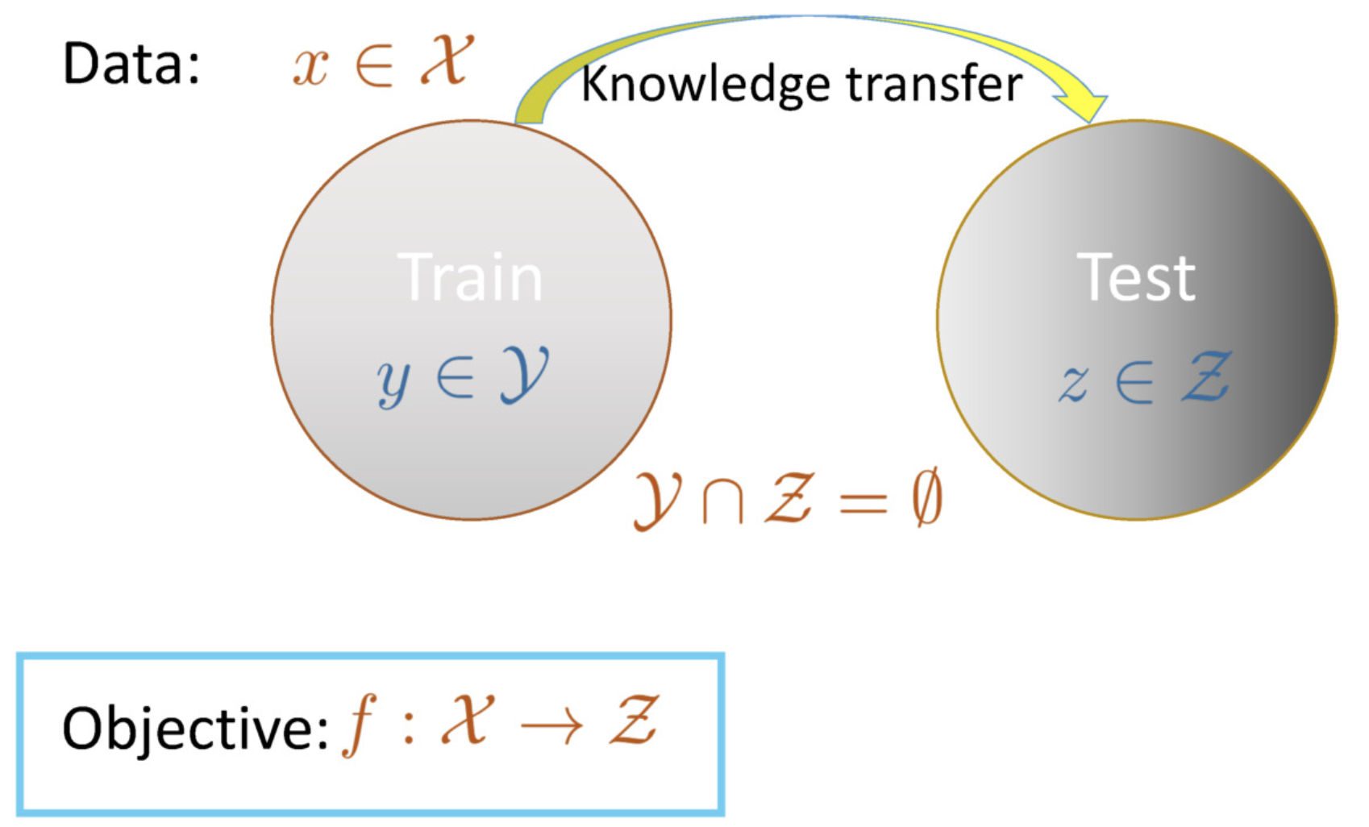
Zero-shot action recognition
[Plot from Zeynep Akata]
How do we know if this is playing tennis without video examples?

Slide 26
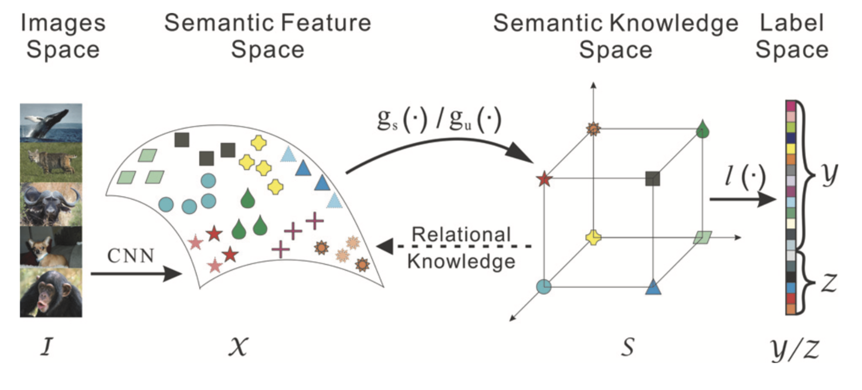
Common approaches to zero-shot learning
[Wang et al. AAAI 2016]
[Mensink et al. CVPR 2014]

Slide 27
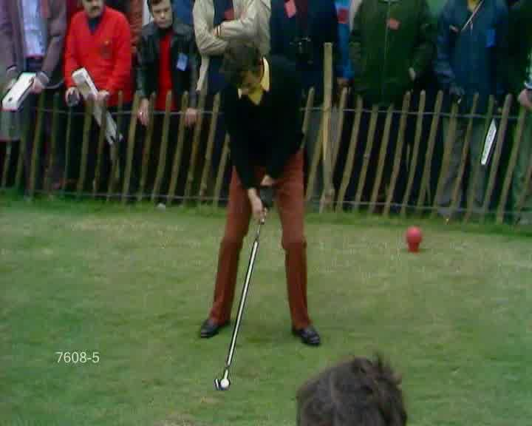
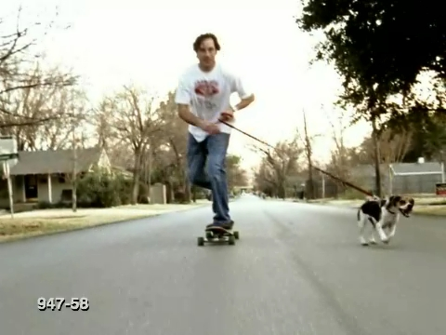
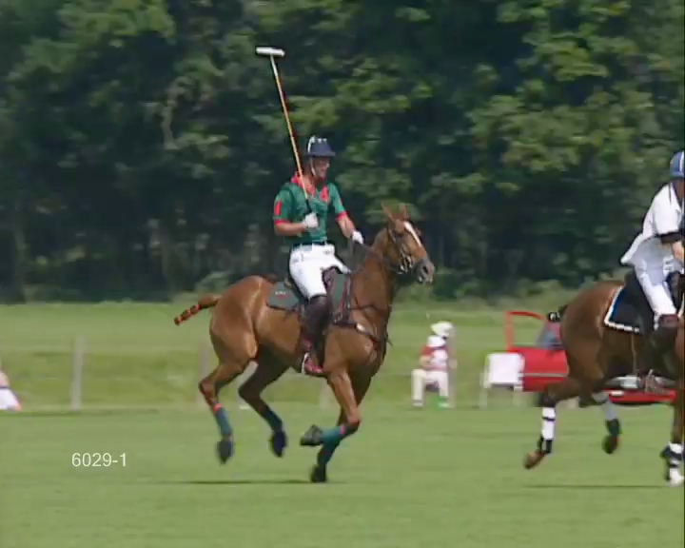
On objects and actions
An action involves an actor trying to act on its environment.
Objects serve as tools to make changes.
Can we recognize and localize actions from objects alone?

Slide 28
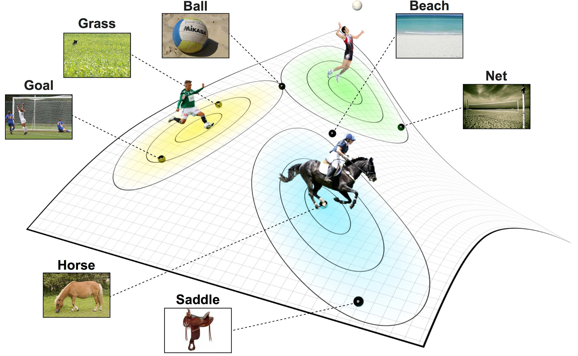
From objects to actions
Pre-train network on images with object annotations.
Get object scores in videos.
Get action score as sum of object scores times semantic relation score to action.
Select highest scoring action.
[Jain et al. ICCV 2015]

Slide 29
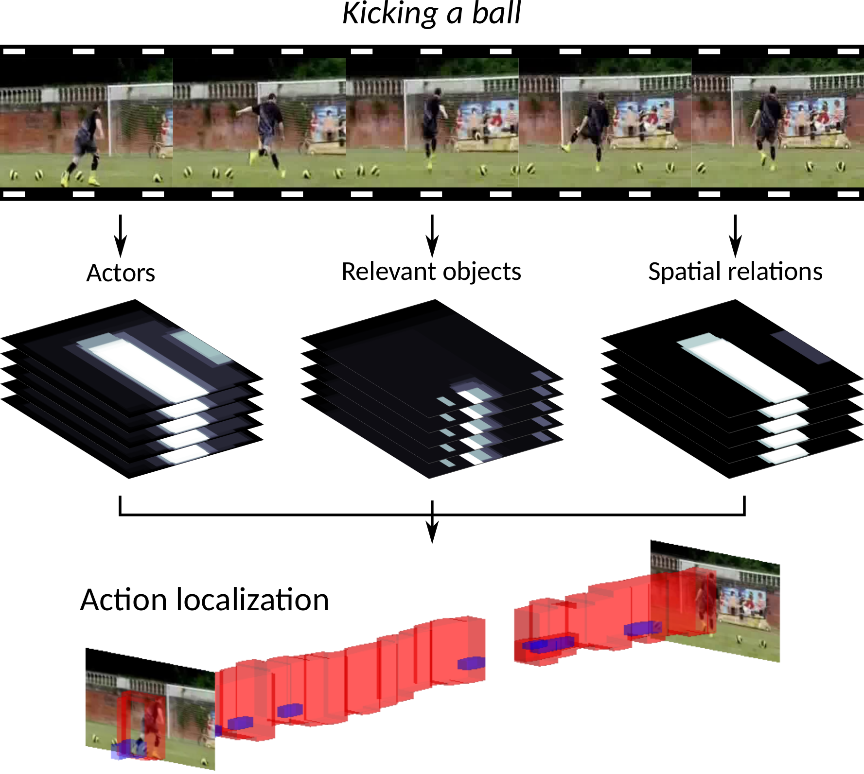
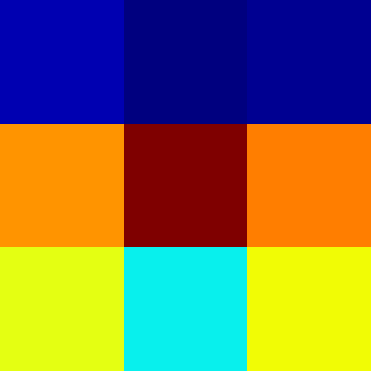
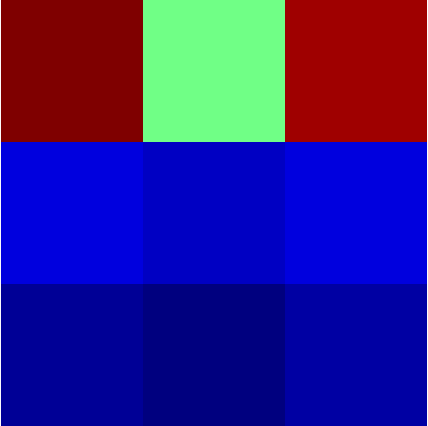
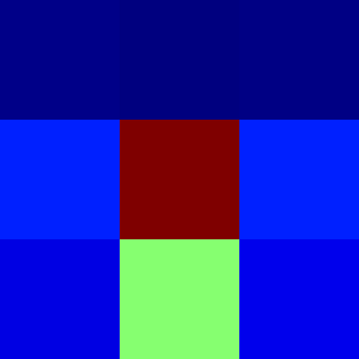
From action recognition to localization
Localize persons and objects locally and incorporate spatial prepositions.
Bicycle
Traffic light
Skateboard
[Mettes and Snoek. ICCV 2017]

Slide 30
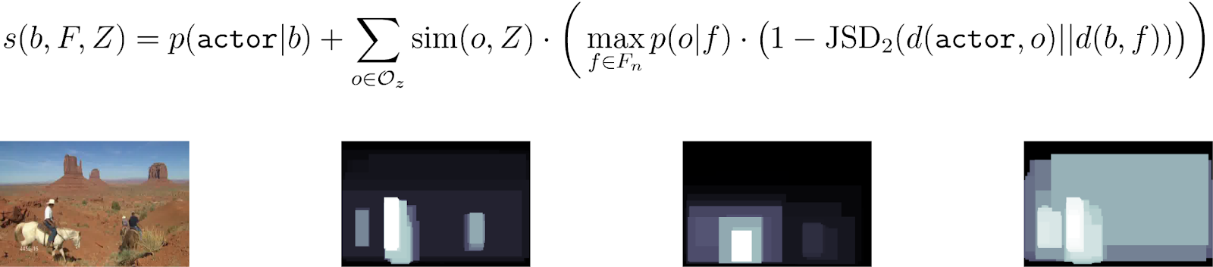
Scoring action boxes
Action decomposition from actors, objects, and spatial relations.
High scoring boxes are linked over time to obtain localization.

Slide 31
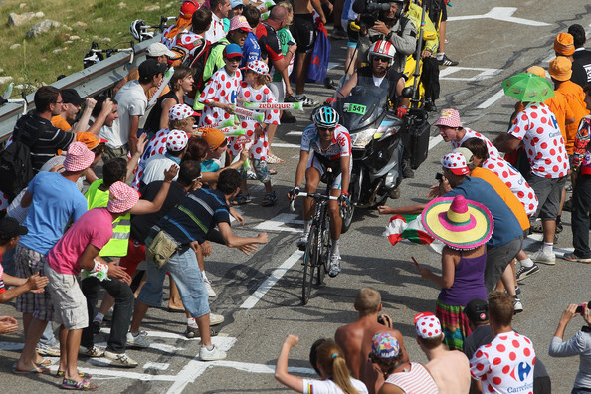
Global and local objects
More bicycles
Concrete road
Polka dot jersey
Crash barrier

Slide 32
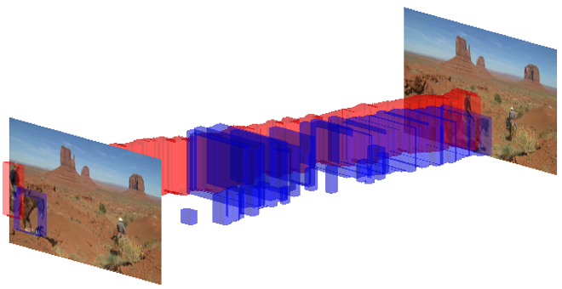
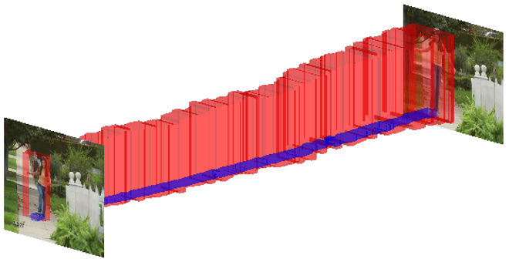
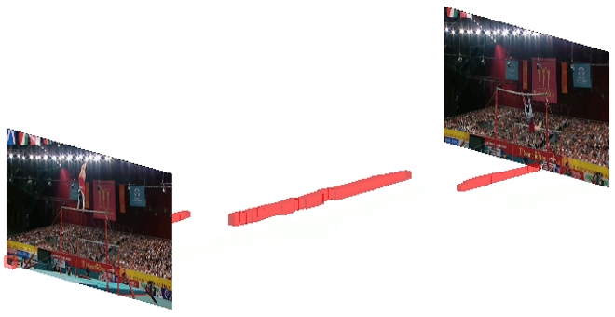
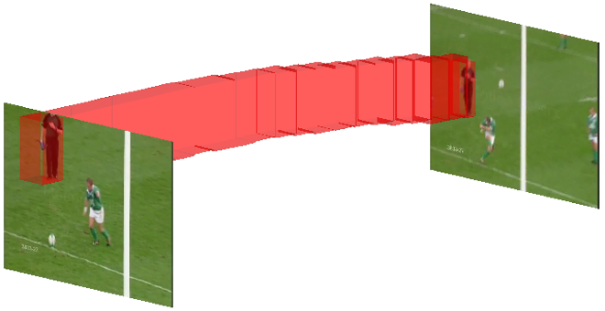
Success and failure cases
Actions missed due to wrong actor focus or semantic ambiguity.
Riding horse (horse)
Skateboarding (skateboard)
Actions localized based on object match and spatial awareness.
Bar swinging (table)
Kicking (tie)

Slide 33
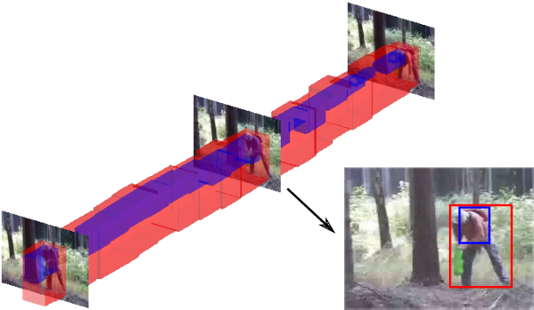
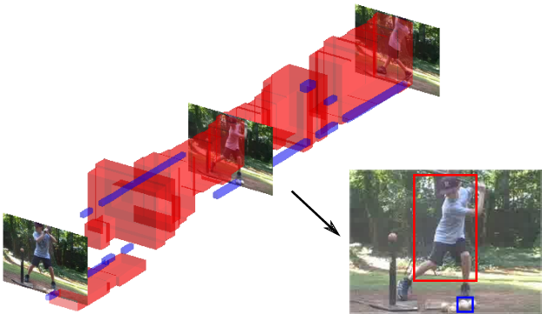
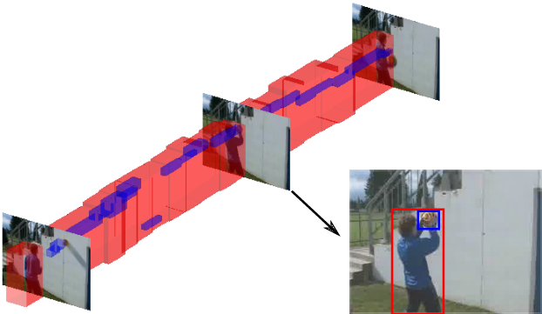
Zero-shot action retrieval
Backpack ON actor
Sports ball (small) RIGHT OF actor
Sports ball (medium) RIGHT OF actor
On-the-fly retrieval for any object, relation, and size.

Slide 34
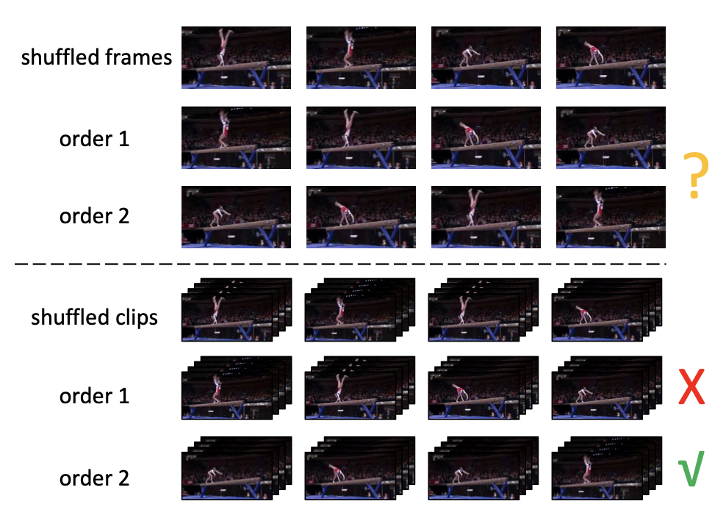
Representation learning without labels
Zero-shot learning: Transfer representations from other sources.
Can we learn representations from data directly without labels?

Slide 35
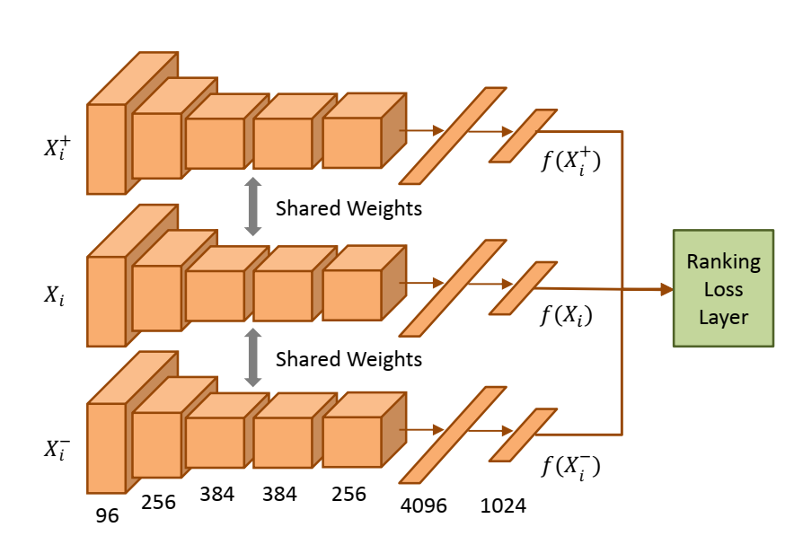
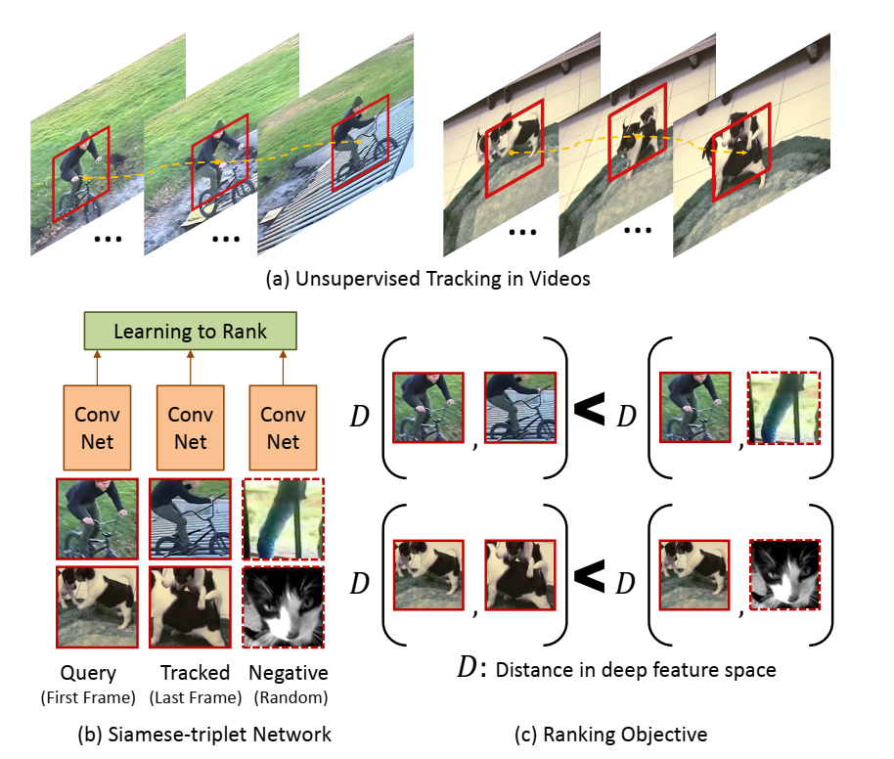
Self-supervised by tracking
[Wang et al. ICCV 2015]
Two patches connected by a track should be visually similar.
Tracks obtained from unsupervised tracking algorithms.
Posed as a verification problem.

Slide 36
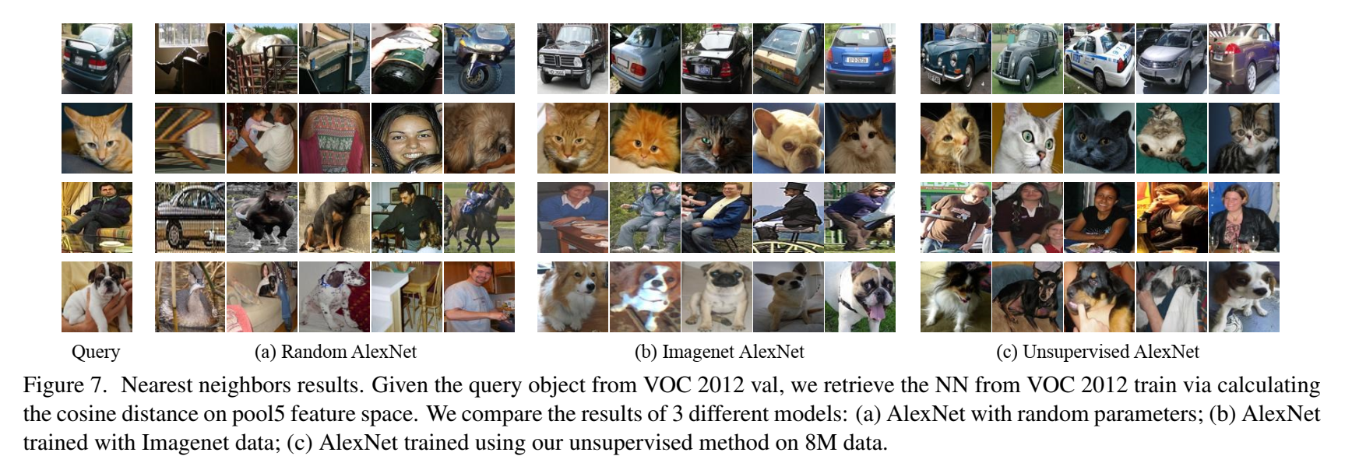
Self-supervised by tracking

Slide 37
Self-supervised by tracking
Generalization to action recognition using features pre-trained on the self-supervised tracking task.
 | UCF101 | HMDB51
Learning by random init. | 38.6% | 13.3%
Learning by tracking pretraining | 40.7% | 15.6%
Imagenet pretraining | 70.1% | 40.8%

Slide 38
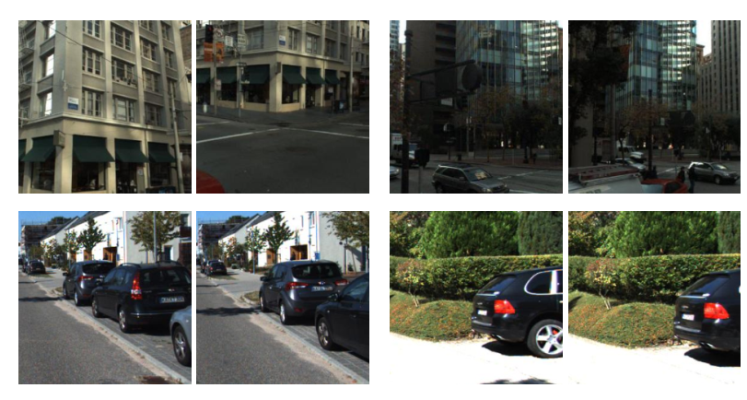
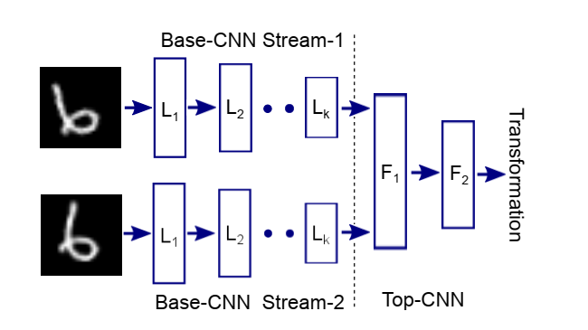
Self-supervised from motion
[Agrawal et al. ICCV 2015]
Idea: use knowledge of camera motion (egomotion) from odometry.
Task: Predict camera transformation between image pairs (tr + rot).

Slide 39
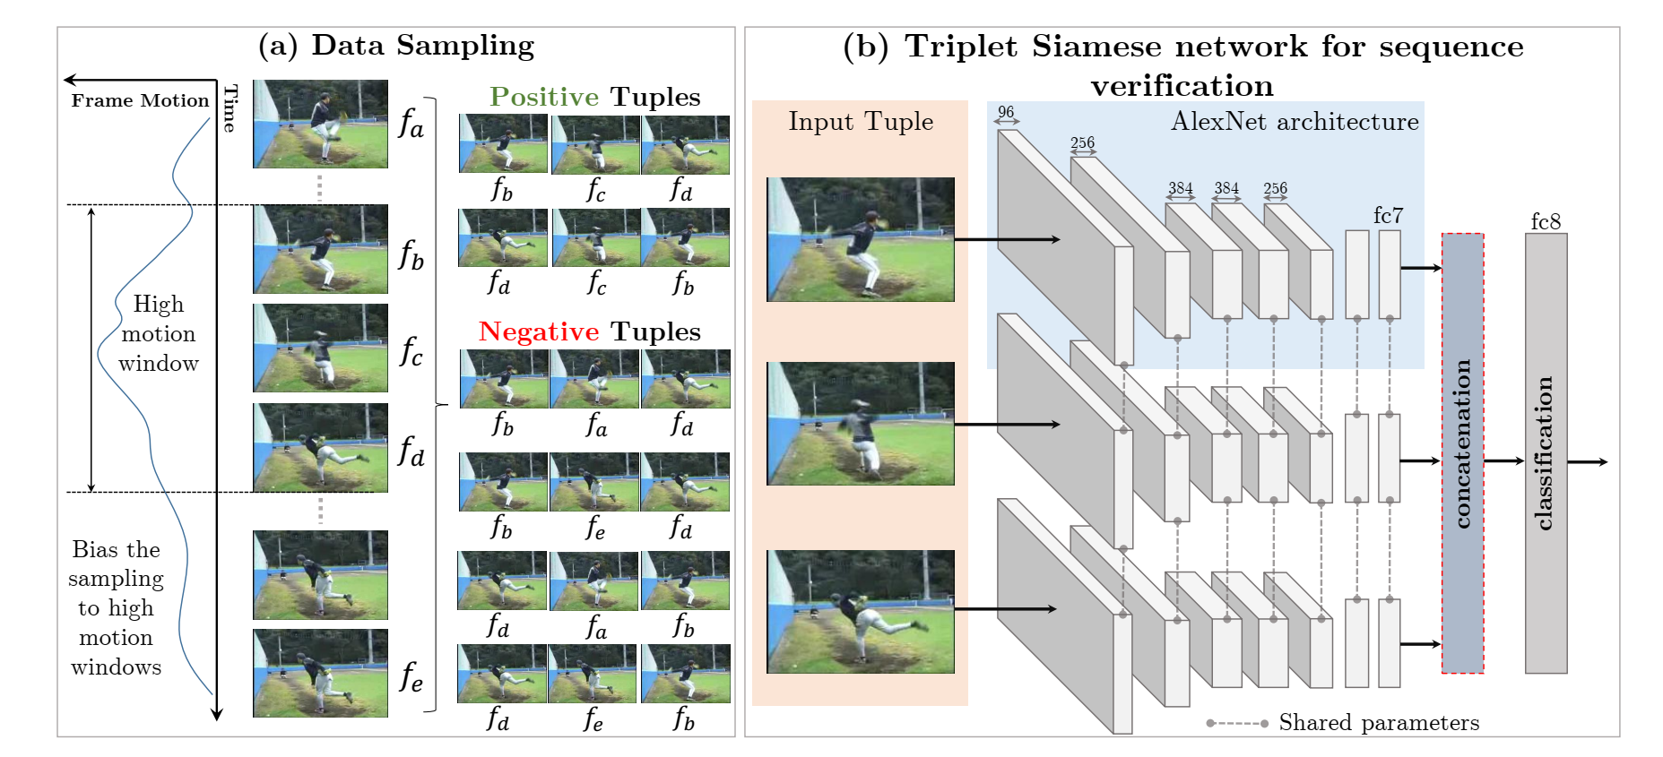
Self-supervised by shuffling
[Misra et al. ECCV 2016]
Idea: Video frames come in a certain order.
Task: Learn temporal structure by determining whether a given sequence is in the right order (binary classification).

Slide 40
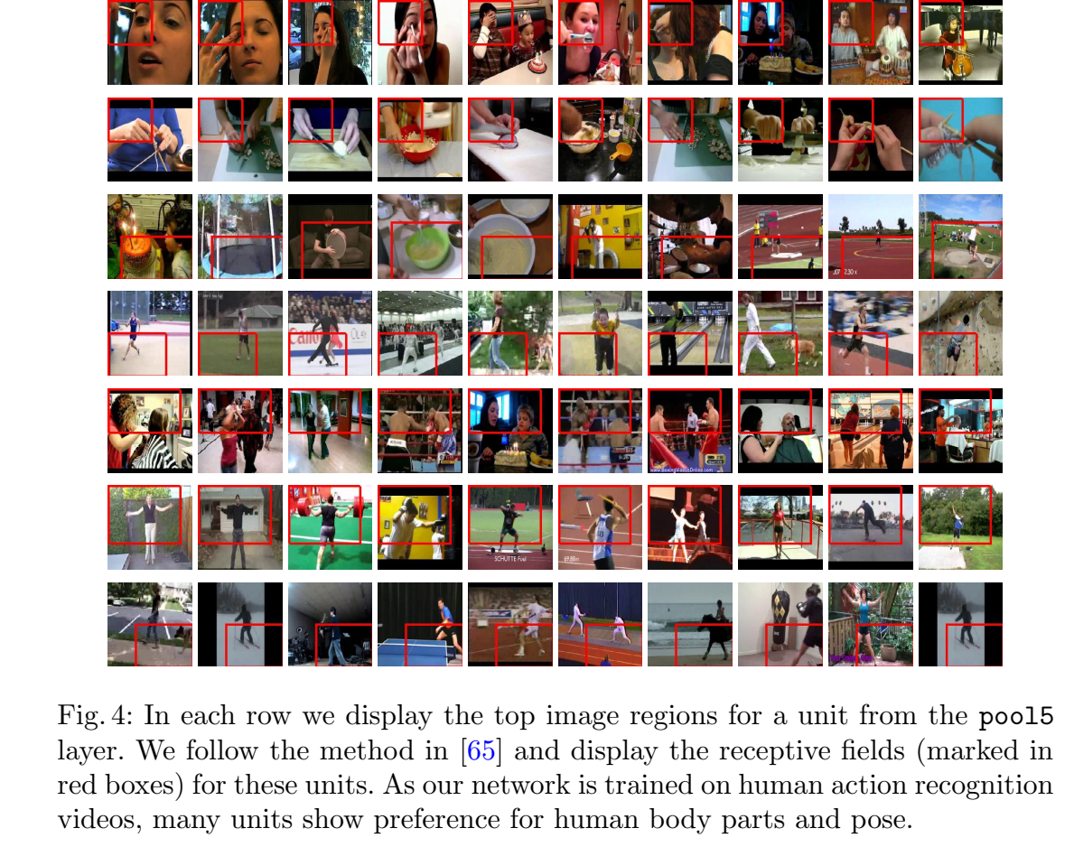
Self-supervised by shuffling

Slide 41
Self-supervised by shuffling
 | UCF101 | HMDB51
Learning by random init. | 38.6% | 13.3%
Learning by tracking | 40.7% | 15.6%
Learning by shuffling | 50.9% | 19.8%

Slide 42
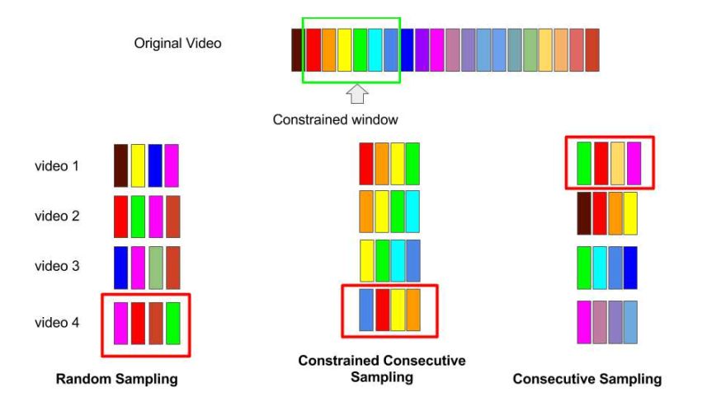
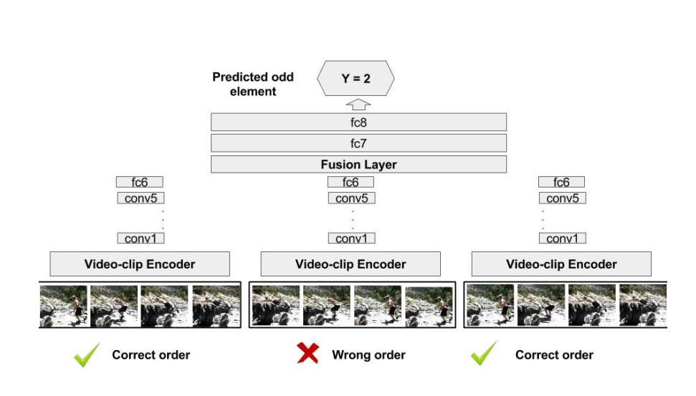
Self-supervised by disorder
[Fernando et al. CVPR 2017]
Again focus on the temporal order of frames.
Task: Identify odd-one-out of a set of videos.
Normal videos in correct order, odd-one in incorrect order.

Slide 43
Self-supervised by disorder
 | UCF101 | HMDB51
Learning by random init. | 38.6% | 13.3%
Learning by tracking | 40.7% | 15.6%
Learning by shuffling | 50.9% | 19.8%
Learning by discovering disorders | 60.3% | 32.5%

Slide 44

Self-supervised by the arrow of time
[Wei et al. CVPR 2018]
Using frames and their order remains a strong starting point.
Task: Learn to predict whether a video is played forward or backward.

Slide 45

Self-supervised by the arrow of time

Slide 46
Self-supervised by the arrow of time
 | UCF101 | HMDB51
Learning by random init. | 38.6% | 13.3%
Learning by tracking | 40.7% | 15.6%
Learning by shuffling | 50.9% | 19.8%
Learning by discovering disorders | 60.3% | 32.5%
Learning by arrow of time | 68.9% | -
Imagenet pretraining | 70.1% | 40.8%

Slide 47

Beyond frame-level self-supervision
[Xu et al. CVPR 2019]
[Tschannen et al. CVPR 2020]

Slide 48
Session III
Recent advances in action understanding

Slide 49

The graph of a video
Actions and interactions are node and edge labels in a video graph.
[Zhang et al. CVPR 2019]

Slide 50

A fixed graph for (inter)action detection

Slide 51


Action detection hardly solved
On standard datasets, we obtain 90-100% accuracy.
Real-world action detection hardly solved.

Slide 52

The temporal graph of complex actions
Which of these sequences constitutes cooking a meal?
[Hussein et al. CVPR 2019]

Slide 53

The temporal graph of complex actions
1. Split a video block into groups
2. Process each group with multi-scale temporal convs
3. Randomly shuffle group order
4. Max-pooling

Slide 54

Anticipating the future
[Chaabane et al. WACV 2020]

Slide 55


Forecasting actions by graph relations
[Sun et al. CVPR 2019]

Slide 56

Example results
Using context
Using relations
Open problems

Slide 57

Future prediction using priors
Can future steps in recipes be predicted without videos of the recipes?
[Sener and Yao. ICCV 2019]

Slide 58


Multi-modal prediction network

Slide 59

Video recognition with prior knowledge
Action recognition typically one-vs-rest.
Action datasets often hierarchical.
Is this useful information and how to use it?

Slide 60
Embedding symbolic hierarchies

Slide 61
Hyperbolic action network

Slide 62


Hyperbolic action network
Position action hierarchy onto hyperbole with two losses:
Idea: obtained action positions become hyperbolic prototypes.
Loss 1: Pull child-parent relations, push others.
Loss 2: Push all actions away from each other.

Slide 63

Hyperbolic action network
Project videos on the same hyperbolic space.
First feed video through a 3D convolutional network.
Project Euclidean output to hyperbole with the exponential map.

Slide 64

Hyperbolic action network
With action hierarchies and videos in same space, match them.
We propose a hyperbolic prototype distance function:

Slide 65

Hierarchical action search
For a query (action name or video example), rank videos based on cosine distance:
Results in a cone search, where we increase the cone size to include related action videos.

Slide 66
Do we learn hierarchical relations?
one-hot
Hyperbolic (this paper)
Hierarchical relations not automatically learned, need to be utilized.

Slide 67
Query examples
Top ranked videos are from same action or hierarchical related actions.

Slide 68
Closing remarks

Slide 69
On action and video learning
Vast research field with many open questions.
Foundational research into network architectures still ongoing.
Strong interest in self-supervised representation learning.
Many new directions: from graphs and futures to priors.

Slide 70

Thank you
P.S.M.Mettes@uva.nl
@PascalMettes
https://staff.fnwi.uva.nl/p.s.m.mettes/index.html

